Slide 1
caAERS Application Development
Presentation to AE SIG
January 25, 2007
Prepared by:
SemanticBits, LLC

Slide 2
Outline of Presentation
Project Timeline and Status Update (5 min)
Demo of caAERS prototype (20 min)

Slide 3
Project Timeline (as of 1/25/06)
Where we are now
Elaboration Phase
2 Months
2 One-Month Iterations
Construction Phase
7 Months
7 One-Month Iterations
Transition
2 weeks

Slide 4
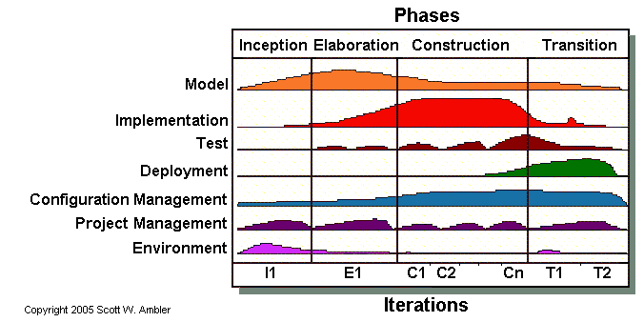
Context for Today’s Prototype Demo
Team has completed 6 weeks of development.
Within the Elaboration Phase of an Agile project.
Focus in this phase weighted towards requirements and analysis. And on implementing Arch. significant and Risky requirements. Ramp up of implementation effort in this phase.

Slide 5
Agile Process
Focus on getting working software out and reviewed at frequent, regular iterations
Based on principle that it is hard for people to know fully what they need at beginning stages of project. It often takes seeing and playing with actual software to determine with confidence what’s needed … or not needed.
Agile Methodology -- Controlled process for building software based on business needs in a dynamic environment with diverse stakeholders.

Slide 6
What is included in this prototype
Core framework, big picture items
  Web Application UI
  Basic Page Flows
Infrastructure and Underlying Components:
  DB
  Grid Services
  Interoperability with other CTMS modules
    Security
    Messaging
    Model/BRIDG Harmonization
    C3PR to caAERS Integration
    caAERS to PSC Integration
    Lab Viewer to caAERS Integration

Slide 7
Use Cases Implemented
Subset of requirements of key use cases:
  1.1 Create Study/Protocol
  1.2 Create Participant
  1.3 Link Participant to Study
  1.4 Create AE
  1.6 AE Data Collection
  Login

Slide 8
Flow of Today’s Demonstration
Create a Study
Create a Participant and Link the Participant to a Study
Create a basic AE for the Participant and record Lab data.
Linking Existing Participant to a Study (Optional, time permitting)

Slide 9
Feedback on All Aspects Welcome
We look forward to your comments, questions, feedback, and even recommended course changes.
In addition to today’s demo, this prototype and each iteration’s prototype will be deployed locally at Adopters site for full scale testing and evaluation.

Slide 10
Demo
Demo of caAERS prototype

